Slide 1


Anthropic Claude for Sheets™ Google Sheets Extension unscripted

Slide 2
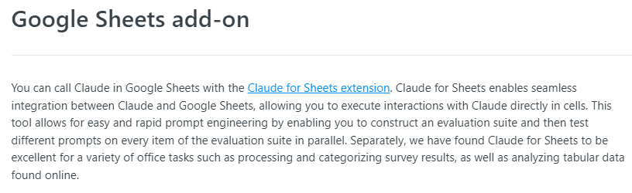
Notes:
https://docs.anthropic.com/claude/docs/google-sheets-add-on
https://docs.anthropic.com/claude/docs/models-overview

Slide 3
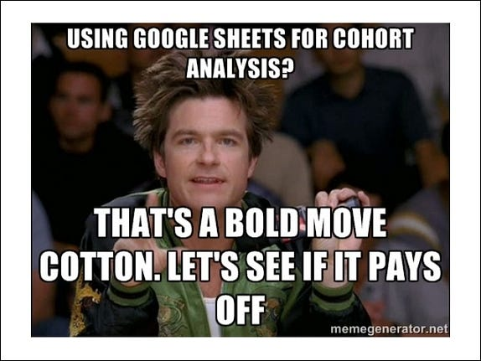
Notes:
https://medium.com/@finnqiao/product-vs-product-google-sheets-vs-airtable-386cb38a31fd

Slide 4
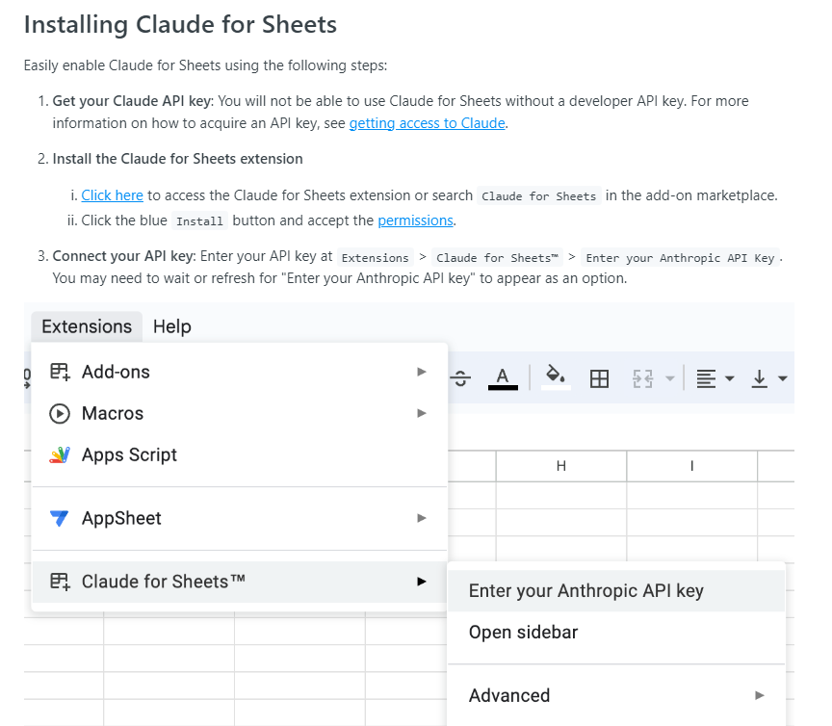

Slide 5
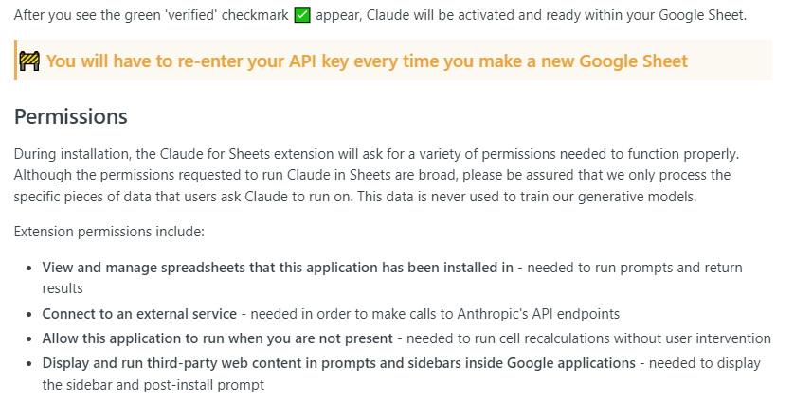

Slide 6
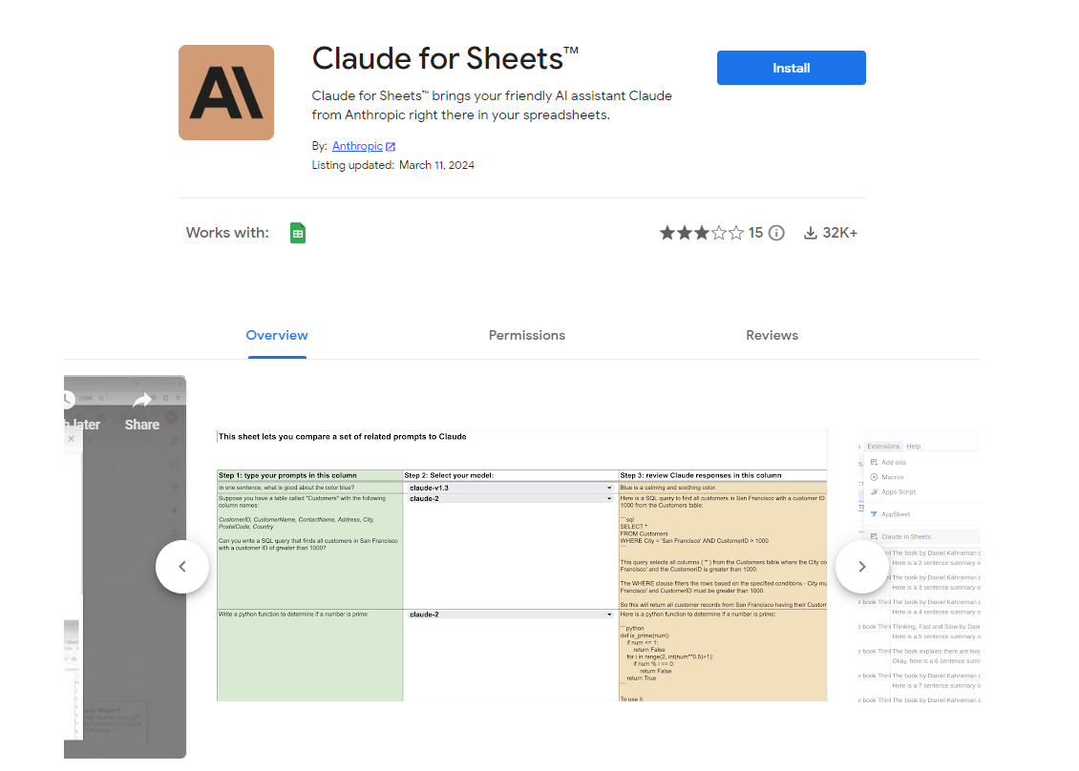
Notes:
https://workspace.google.com/marketplace/app/claude_for_sheets/909417792257
https://www.youtube.com/watch?v=jRlOyDAC5Pg

Slide 7
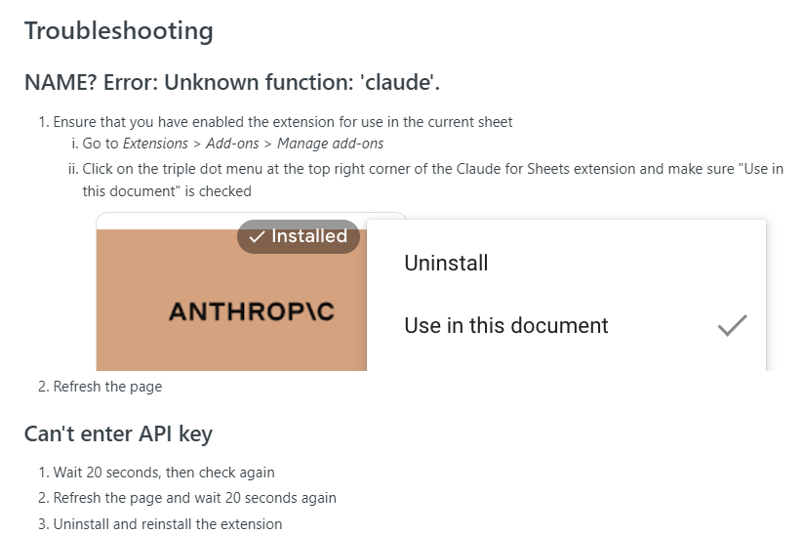

Slide 8
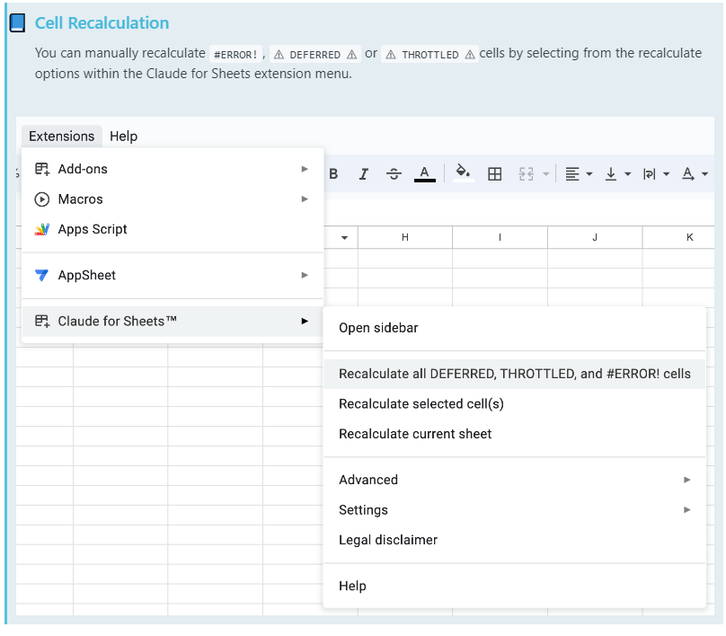

Slide 9
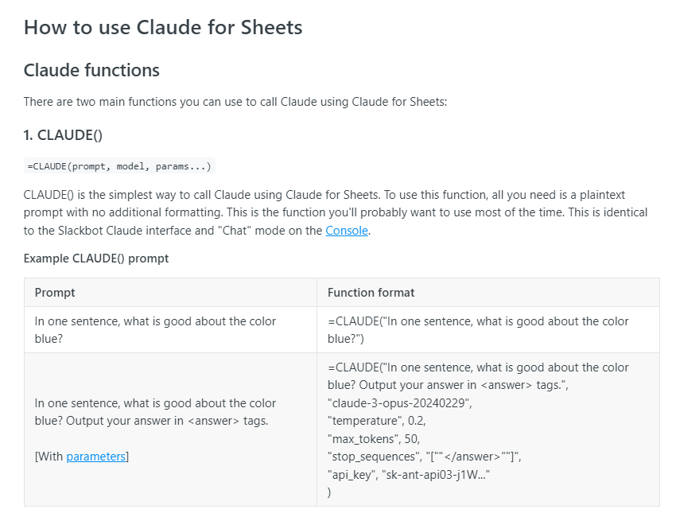

Slide 10
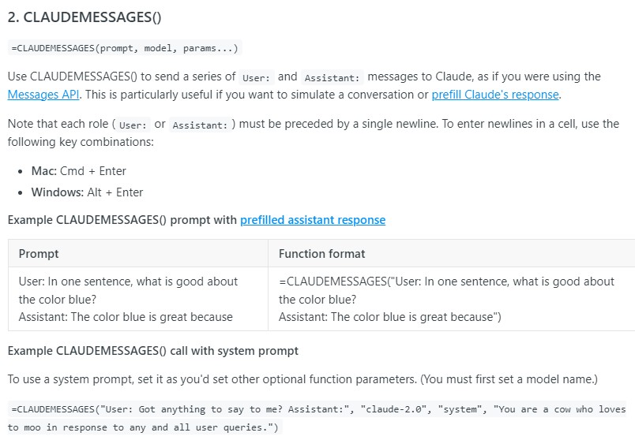

Slide 11
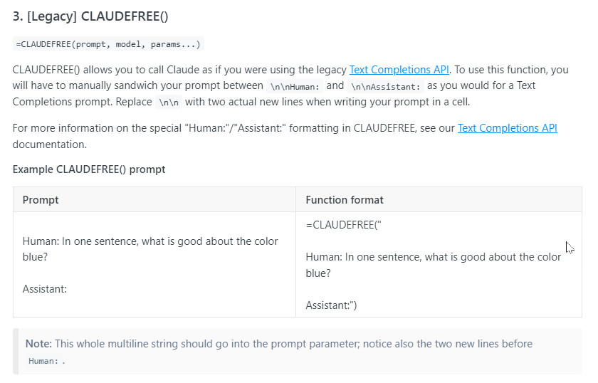

Slide 12
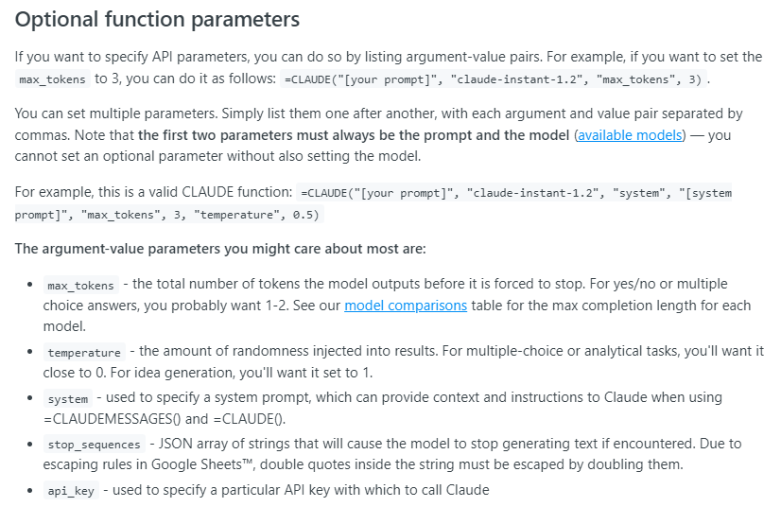

Slide 13
